Slide 1
DSA-II Project - DNA SEQUENCING
By: Syed Muhammad Hunain Abbas Zaidi
M. Ahmad Hanif Hamza Ansari
Muhammad Farzam Ghouri

Slide 2
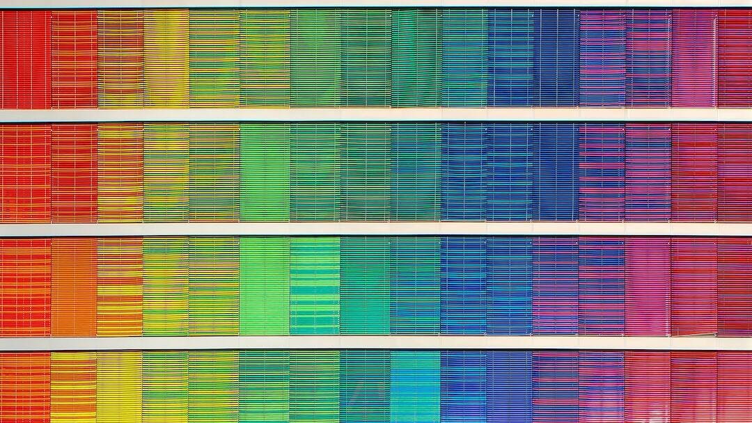
Introduction to Bioinformatics
Understanding Life at a Molecular Level: Bioinformatics combines biology, computer science, and information technology to understand biological data.
Importance of Sequence Alignment: Essential for identifying similarities and differences in the DNA, RNA, and protein sequences, leading to discoveries in genetic diseases and evolutionary studies.
Objective of Our Project: To provide a user-friendly tool for conducting accurate and efficient sequence alignments, aiding researchers and scientists in their analyses.
Photo by Ricardo Gomez Angel on Unsplash

Slide 3
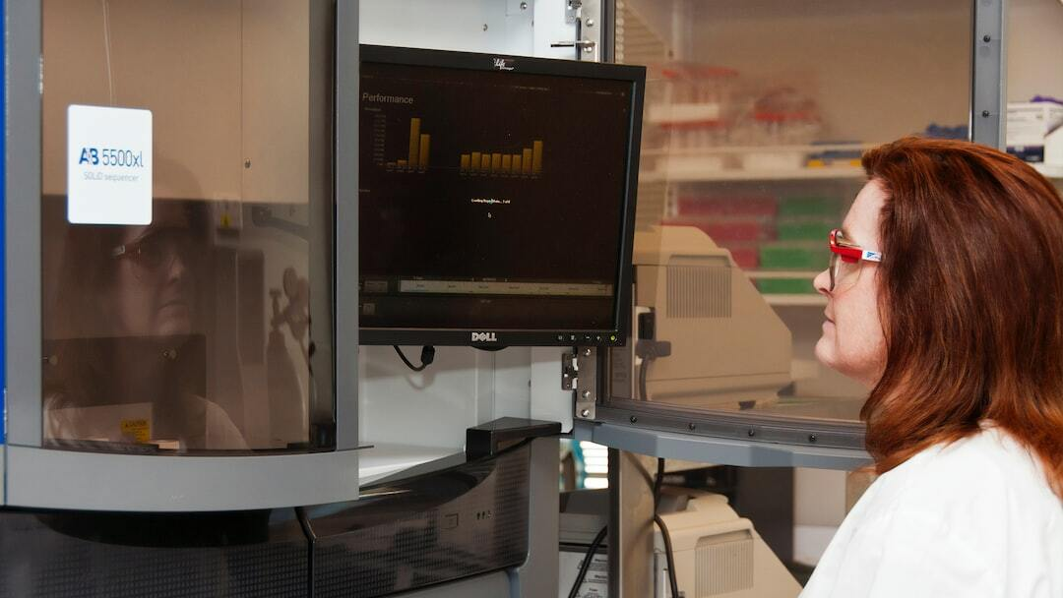
Project Functionalities
Global Sequence Alignment: The Needleman-Wunsch algorithm provides a comprehensive analysis of sequences, essential for comparative genomics studies.
Local Sequence Alignment: The Smith-Waterman algorithm allows researchers to identify functional domains and similarities among diverse sequences.
Protein translation and Disease Prediction: The application mimics the gene expression process, specifically transcription and translation, which are central to molecular biology.
Photo by National Cancer Institute on Unsplash

Slide 4
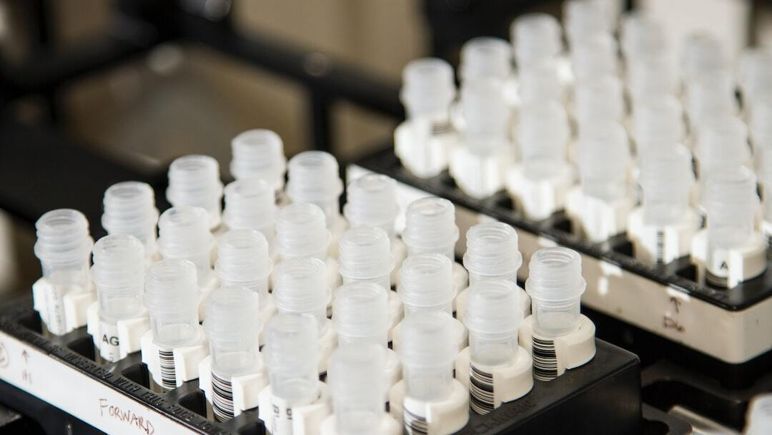
Data Structures in Bioinformatics
Scoring Matrices: Utilized in alignment algorithms to quantify the similarity between DNA, RNA, or protein sequences.
Traceback Matrices: Facilitates the reconstruction of the alignment path, revealing the optimal sequence alignment.
Binary Trees: Employs binary trees to model hierarchical relationships and visualize protein sequence structures.
Smith-Waterman Algorithm
Needleman-Wunsch Algorithm
Photo by National Cancer Institute on Unsplash

Slide 5
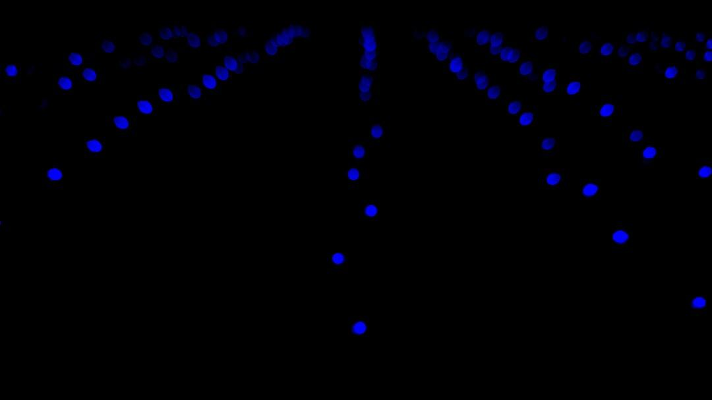
Exploring the Smith-Waterman Algorithm
Purpose: The Smith-Waterman algorithm, developed by Temple F. Smith and Michael S. Waterman in 1981, is a local sequence alignment method used primarily in bioinformatics for comparing segments of biological sequences.
Dynamic Programming Approach: Uses a dynamic programming matrix to find the local subsequences that align best, rather than the entire sequence, focusing on the highest scoring segment matches.
Adjustable Scoring: Incorporates a scoring system that awards points for matches and penalizes mismatches and gaps, which can be adjusted based on the biological context to optimize results.
Photo by Chirayu Trivedi on Unsplash

Slide 6
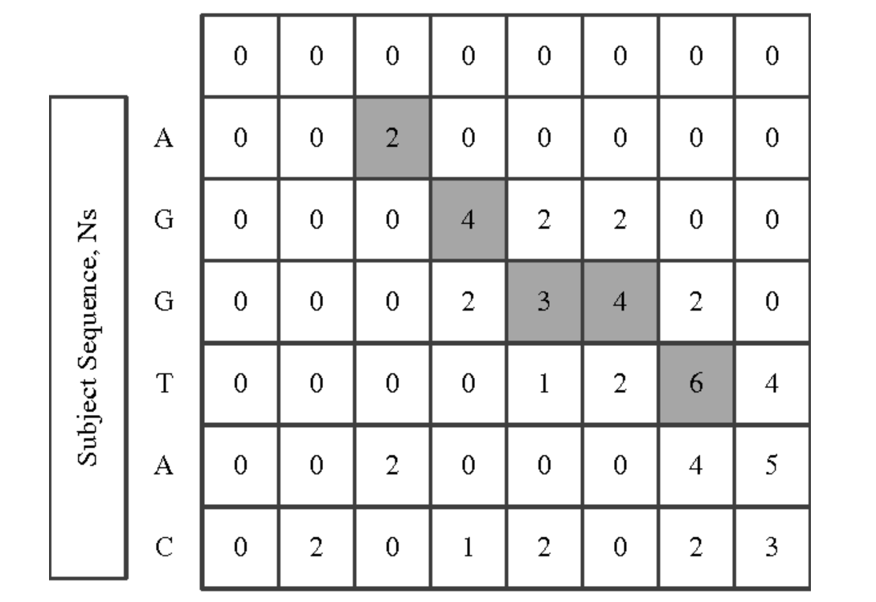
EXAMPLE OF Smith-Waterman Algorithm

Slide 7
The Importance of the Smith-Waterman Algorithm
Precision in Local Alignments: Excels in identifying highly similar regions within large sequences or across different sequences, crucial for detailed genetic analysis and mutation detection.
Key Applications: Widely used in molecular biology to understand protein functions, detect evolutionary relationships, and assist in drug development by identifying active sites.
Impact on Bioinformatics Tools: Serves as a basis for many advanced bioinformatics software, improving the accuracy and efficiency of sequence analysis and biological data interpretation.
Photo by Chirayu Trivedi on Unsplash

Slide 8

Understanding the Needleman-Wunsch Algorithm
Purpose: Developed in 1970 by Saul B. Needleman and Christian D. Wunsch, this algorithm is a foundational method for sequence alignment in bioinformatics, specifically for aligning protein or nucleotide sequences.
Algorithmic Overview: Operates using a dynamic programming matrix to systematically compare every character of two sequences, placing them in an optimal alignment based on a scoring system that accounts for matches, mismatches, and gaps.
Score Matrix: Constructs a matrix where each cell represents the maximum score at that position derived from three possible scenarios: a match/mismatch directly above, directly to the left, or diagonally (indicating a sequence continuation or gap).
Photo by Isaac Smith on Unsplash

Slide 9
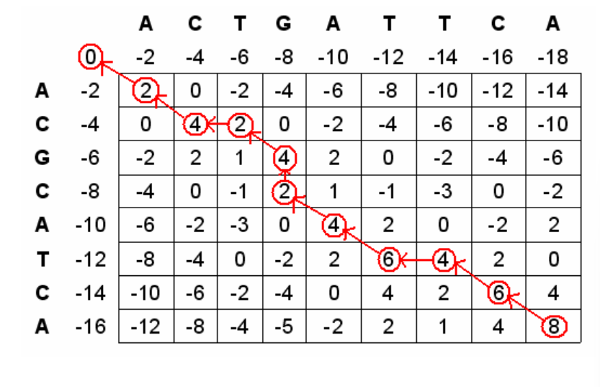
EXAMPLE OF Needleman-Wunsch Algorithm

Slide 10
The Value of the Needleman-Wunsch Algorithm
High Accuracy: Delivers highly accurate results by considering all possible alignments with equal chance before deciding the best alignment, minimizing bias in sequence comparison.
Applications in Bioinformatics: Crucial for genetic research and drug discovery as it helps identify evolutionary relationships, predict protein functions, and understand genetic mutations.
Foundational in Comparative Genomics: Forms the basis for more complex bioinformatics tools and techniques, facilitating the study of biological data and contributing to advances in medical and agricultural sciences.
Photo by Isaac Smith on Unsplash

Slide 11
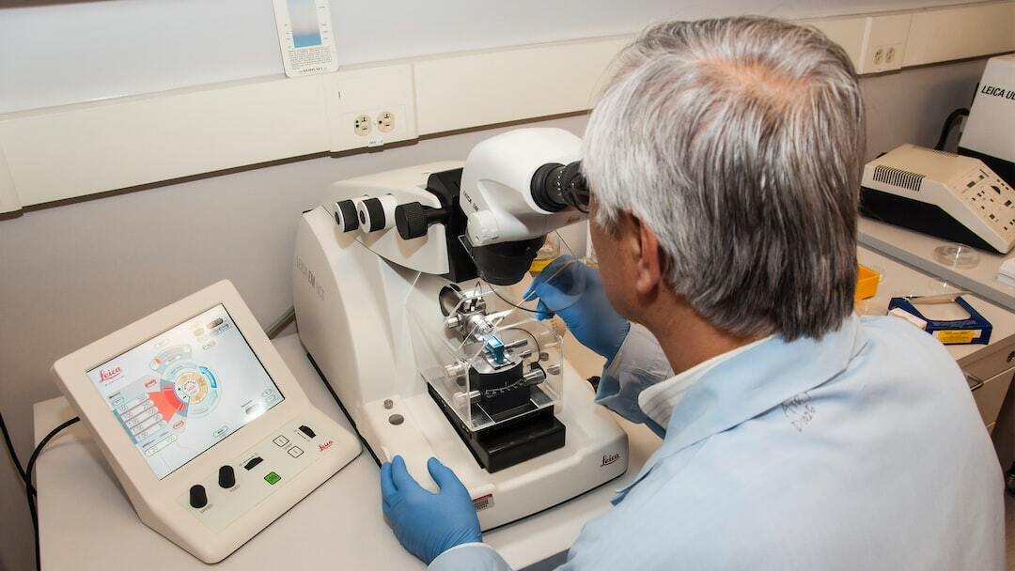
Real-Life Applications
Genetic Research: Enables researchers to compare genomes, understand evolutionary relationships, and discover genetic markers.
Medical Diagnostics: Assists in identifying genetic diseases and mutations by comparing patient DNA sequences with reference genomes.
Pharmaceuticals: Aids in drug development by analyzing protein structures and interactions, leading to targeted therapies.
Agriculture: Helps in crop improvement by sequencing and comparing plant genomes for traits like disease resistance and yield.
Photo by National Cancer Institute on Unsplash

Slide 12
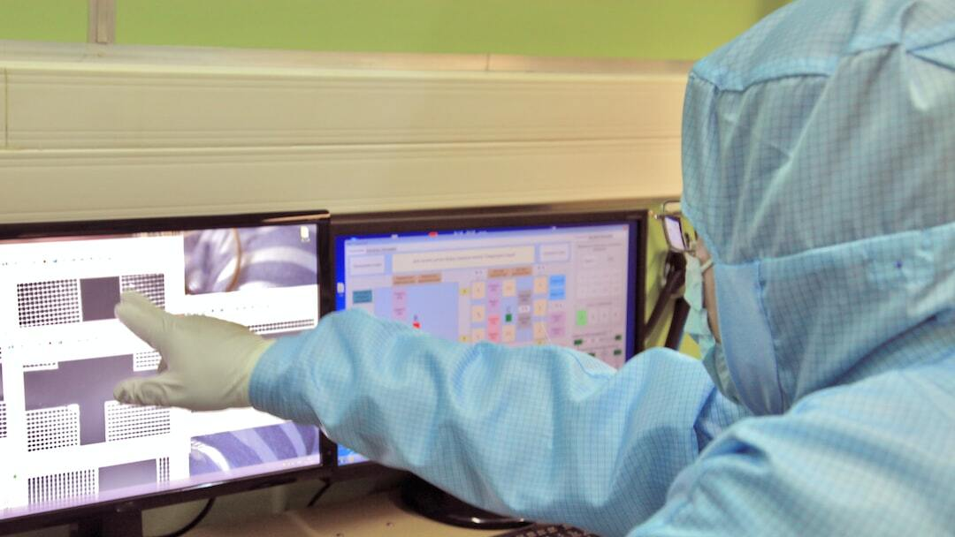
Conclusion
Project Recap: We ventured into the realm of bioinformatics with powerful algorithms and a task management system to enhance research capabilities.
Future Directions: The project paves the way for further innovations in genetic analysis, personalized medicine, and sustainable agriculture.
Continued Evolution: Ongoing development and integration of advanced computational methods will continue to revolutionize the field of biology.
Photo by Dmitriy Suponnikov on Unsplash

